Slide 1

Cryptography and Network Security
Seventh Edition
by William Stallings
Notes:
Lecture slides prepared for “Cryptography and Network Security”, 7/e, by William Stallings, Chapter 5 – “Finite Fields”.

Slide 2
Chapter 5
Finite Fields
Notes:
Finite fields have become increasingly important in cryptography. A number of
cryptographic algorithms rely heavily on properties of finite fields, notably the
Advanced Encryption Standard (AES) and elliptic curve cryptography. Other examples
include the message authentication code CMAC and the authenticated encryption
scheme GCM.
This chapter provides the reader with sufficient background on the concepts of
finite fields to be able to understand the design of AES and other cryptographic algorithms
that use finite fields. Because students unfamiliar with abstract algebra may find
the concepts behind finite fields somewhat difficult to grasp, we approach the topic in a
way designed to enhance understanding. Our plan of attack is as follows:
1. Fields are a subset of a larger class of algebraic structures called rings, which
are in turn a subset of the larger class of groups. In fact, as shown in Figure 5.1,
both groups and rings can be further differentiated. Groups are defined by
a simple set of properties and are easily understood. Each successive subset
(abelian group, ring, commutative ring, and so on) adds additional properties
and is thus more complex. Sections 5.1 through 5.3 will examine groups, rings,
and fields, successively.
2. Finite fields are a subset of fields, consisting of those fields with a finite number
of elements. These are the class of fields that are found in cryptographic
algorithms. With the concepts of fields in hand, we turn in Section 5.4 to a
specific class of finite fields, namely those with p elements, where p is prime.
Certain asymmetric cryptographic algorithms make use of such fields.
3. A more important class of finite fields, for cryptography, comprises those with
2^{n} elements depicted as fields of the form GF(2^{n} ). These are used in a wide
variety of cryptographic algorithms. However, before discussing these fields, we
need to analyze the topic of polynomial arithmetic, which is done in Section 5.5.
4. With all of this preliminary work done, we are able at last, in Section 5.6, to
discuss finite fields of the form GF(2^{n} ).
Before proceeding, the reader may wish to review Sections 2.1 through 2.3, which
cover relevant topics in number theory.

Slide 3
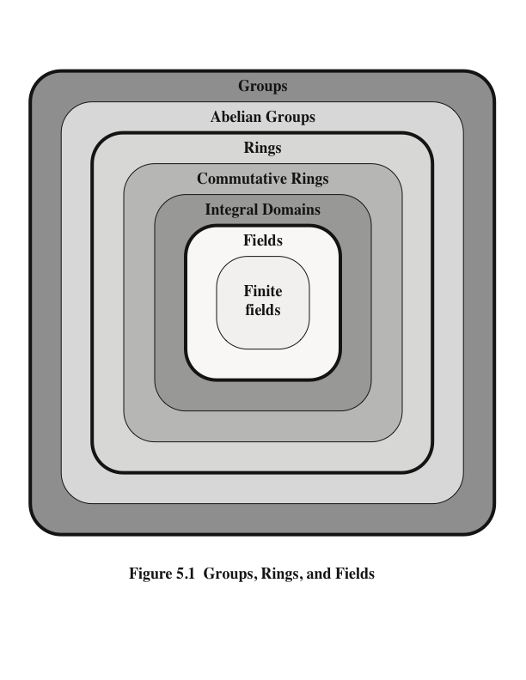
Notes:
Groups, rings, and fields are the fundamental elements of a branch of mathematics
known as abstract algebra, or modern algebra. In abstract algebra, we are concerned
with sets on whose elements we can operate algebraically; that is, we can combine
two elements of the set, perhaps in several ways, to obtain a third element of the set.
These operations are subject to specific rules, which define the nature of the set. By
convention, the notation for the two principal classes of operations
on set elements is usually the same as the notation for addition and multiplication on ordinary numbers.
However, it is important to note that, in abstract algebra, we are not limited to
ordinary arithmetical operations. All this should become clear as we proceed.

Slide 4
Groups
A set of elements with a binary operation denoted by • that associates to each ordered pair (a,b) of elements in G an element (a • b ) in G , such that the following axioms are obeyed:
  (A1) Closure:
    If a and b belong to G, then a • b is also in G
  (A2) Associative:
    a • (b • c) = (a • b) • c for all a, b, c in G
  (A3) Identity element:
    There is an element e in G such that a • e = e • a = a for all a in G
  (A4) Inverse element:
    For each a in G, there is an element a¹ in G such that a•a¹ = a¹ • a = e
  (A5) Commutative:
    a • b = b • a for all a, b in G
Notes:
A group G , sometimes denoted by {G , * }, is a set of elements with a binary operation
denoted by * that associates to each ordered pair (a, b ) of elements in G an element
(a * b ) in G , such that the following axioms are obeyed:
(A1) Closure:
If a and b belong to G, then a * b is also in G
(A2) Associative:
a * (b * c) = (a * b) * c for all a, b, c in G
(A3) Identity element:
There is an element e in G such that a * e = e * a = a for all a in G
(A4) Inverse element:
For each a in G, there is an element a¹ in G such that a*a¹ = a¹ * a = e
(A5) Commutative:
a * b = b * a for all a, b in G
If a group has a finite number of elements, it is referred to as a finite group , and
the order of the group is equal to the number of elements in the group. Otherwise,
the group is an infinite group .
A group is said to be abelian if it satisfies the following additional condition:
(A5) Commutative: a * b = b * a for all a, b in G.

Slide 5
Cyclic Group
Exponentiation is defined within a group as a repeated application of the group operator, so that a³ = a•a•a
We define a⁰ = e as the identity element, and a^{-n} = (a’)^{n} , where a’ is the inverse element of a within the group
A group G is cyclic if every element of G is a power a^{k} (k is an integer) of a fixed element a € G
The element a is said to generate the group G or to be a generator of G
A cyclic group is always abelian and may be finite or infinite
Notes:
We define exponentiation in a group as the repeated use of the group operator. Note that we are most familiar with it being applied to multiplication, but it is more general than that. If the repeated use of the operator on some value a in the group results in every possible value being created, then the group is said to be cyclic, and a is a generator of (or generates) the group G.

Slide 6
Rings
A ring R , sometimes denoted by {R , + , * }, is a set of elements with two binary operations, called addition and multiplication, such that for all a , b , c in R the following axioms are obeyed:
(A1–A5)
  R is an abelian group with respect to addition; that is, R satisfies axioms A1 through A5. For the case of an additive group, we denote the identity element as 0 and the inverse of a as –a
  (M1) Closure under multiplication:
  If a and b belong to R , then ab is also in R
(M2) Associativity of multiplication:
a (bc ) = (ab)c for all a , b , c in R
(M3) Distributive laws:
a (b + c ) = ab + ac for all a , b , c in R
  (a + b )c = ac + bc for all a , b , c in R
In essence, a ring is a set in which we can do addition, subtraction [a - b = a + (-b )], and multiplication without leaving the set
Notes:
A ring R , sometimes denoted by {R , + , * }, is a set of elements with two binary operations, called addition and multiplication, such that for all a , b , c in R the following axioms are obeyed:
(A1–A5)
R is an abelian group with respect to addition; that is, R satisfies axioms A1 through A5. For the case of an additive group, we denote the identity element as 0 and the inverse of a as –a
(M1) Closure under multiplication:
If a and b belong to R , then ab is also in R
(M2) Associativity of multiplication:
a (bc ) = (ab)c for all a , b , c in R
(M3) Distributive laws:
a (b + c ) = ab + ac for all a , b , c in R
(a + b )c = ac + bc for all a , b , c in R
In essence, a ring is a set in which we can do addition, subtraction [a - b = a + (-b )], and multiplication without leaving the set

Slide 7
Rings (cont.)
A ring is said to be commutative if it satisfies the following additional condition:
(M4) Commutativity of multiplication:
ab = ba for all a, b in R
An integral domain is a commutative ring that obeys the following axioms.
(M5) Multiplicative identity:
There is an element 1 in R such that a1 = 1a = a for all a in R
(M6) No zero divisors:
If a , b in R and ab = 0, then either a = 0 or b = 0
Notes:
A ring is said to be commutative if it satisfies the following additional condition:
(M4) Commutativity of multiplication:
ab = ba for all a, b in R
An integral domain is a commutative ring that obeys the following axioms.
(M5) Multiplicative identity:
There is an element 1 in R such that a 1 = 1a = a for all a in R
(M6) No zero divisors:
If a , b in R and ab = 0, then either a = 0 or b = 0

Slide 8
Fields
A field F , sometimes denoted by {F, +,* }, is a set of elements with two binary operations, called addition and multiplication, such that for all a, b, c in F the following axioms are obeyed:
(A1–M6)
F is an integral domain; that is, F satisfies axioms A1 through A5 and M1
through M6
(M7) Multiplicative inverse:
For each a in F, except 0, there is an element a⁻¹ in F such that aa⁻¹ = (a⁻¹ )a = 1
In essence, a field is a set in which we can do addition, subtraction, multiplication, and division without leaving the set. Division is defined with the following rule: a /b = a (b⁻¹ )
Familiar examples of fields are the rational numbers, the real numbers, and the complex numbers. Note that the set of all integers is not a field, because not every element of the set has a multiplicative inverse.
Notes:
A field F , sometimes denoted by {F , + , * }, is a set of elements with two binary operations,
called addition and multiplication , such that for all a , b , c in F the following
axioms are obeyed.
(A1–M6) F is an integral domain; that is, F satisfies axioms A1 through A5 and
M1 through M6.
(M7) Multiplicative inverse: For each a in F , except 0, there is an element
a⁻¹ in F such that aa⁻¹ = (a⁻¹ )a = 1.
In essence, a field is a set in which we can do addition, subtraction, multiplication,
and division without leaving the set. Division is defined with the following rule:a /b = a (b⁻¹ ).

Slide 9
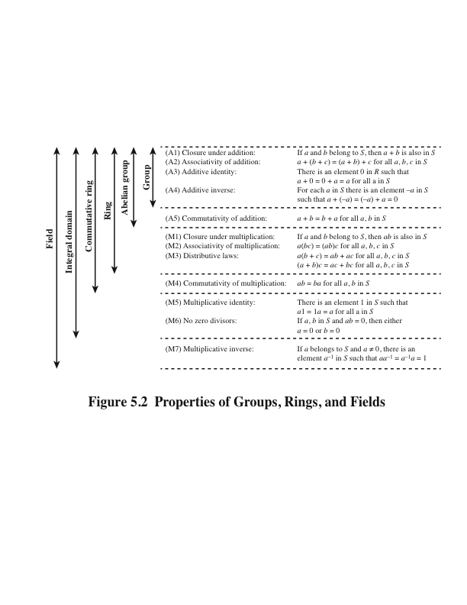
Notes:
Figure 5.2 summarizes the axioms that define groups, rings, and fields.

Slide 10
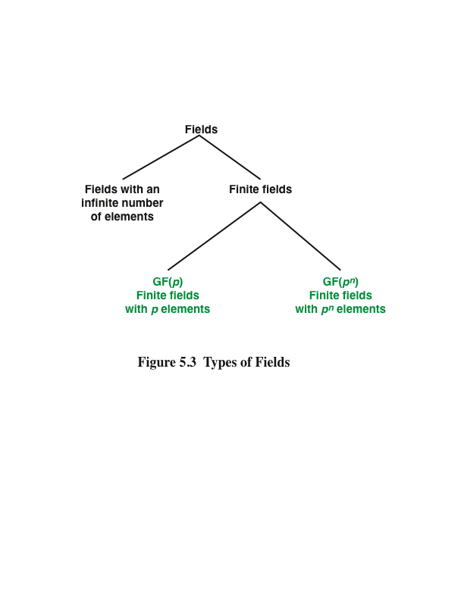
Notes:
In Section 5.3, we defined a field as a set that obeys all of the axioms of Figure 5.2
and gave some examples of infinite fields. Infinite fields are not of particular interest
in the context of cryptography. However, in addition to infinite fields, there are
two types of finite fields, as illustrated in Figure 5.3. Finite fields play a crucial role
in many cryptographic algorithms.

Slide 11
Finite Fields of the Form GF(p)
Finite fields play a crucial role in many cryptographic algorithms
It can be shown that the order of a finite field must be a power of a prime p^{n}, where n is a positive integer
  The finite field of order p^{n} is generally written GF(p^{n} )
  GF stands for Galois field, in honor of the mathematician who first studied finite fields
Notes:
It can be shown that the order of a finite field (number of
elements in the field) must be a power of a prime p^{n} , where n is a positive integer.
The finite field of order p^{n} is generally written GF(p^{n}); GF stands for Galois
field, in honor of the mathematician who first studied finite fields. Two special cases
are of interest for our purposes. For n = 1, we have the finite field GF(p); this finite
field has a different structure than that for finite fields with n > 1 and is studied in
this section.

Slide 12
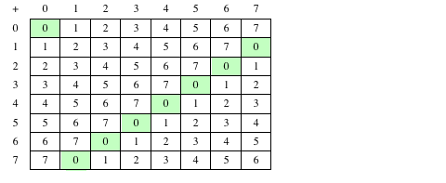
Table 5.1(a)
(a) Addition modulo 8
Notes:
Table 5.1 Arithmetic Modulo 8 and Modulo 7

Slide 13
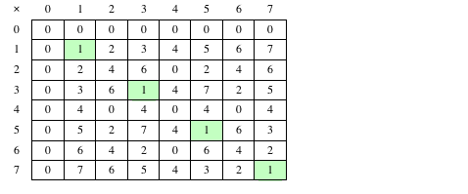
Table 5.1(b)
(b) Multiplication modulo 8
Notes:
Table 5.1 Arithmetic Modulo 8 and Modulo 7

Slide 14
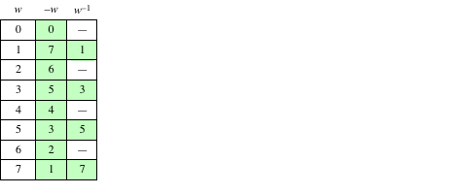
Table 5.1(c)
(c) Additive and multiplicative
inverses modulo 8
Notes:
Table 5.1 Arithmetic Modulo 8 and Modulo 7

Slide 15
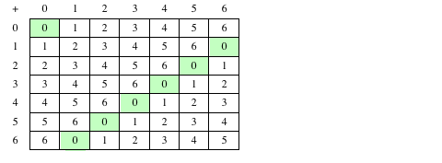
Table 5.1(d)
(d) Addition modulo 7
Notes:
Table 5.1 Arithmetic Modulo 8 and Modulo 7

Slide 16
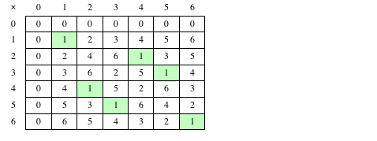
Table 5.1(e)
(e) Multiplication modulo 7
Notes:
Table 5.1 Arithmetic Modulo 8 and Modulo 7

Slide 17
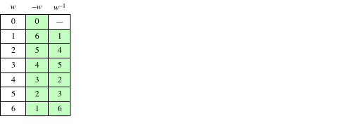
Table 5.1(f)
(f) Additive and multiplicative
inverses modulo 7
Notes:
Table 5.1 Arithmetic Modulo 8 and Modulo 7

Slide 18
In this section, we have shown how to construct a finite field of order p, where p is prime.
GF(p) is defined with the following properties:
1. GF(p) consists of p elements
2. The binary operations + and * are defined over the set. The operations of addition, subtraction, multiplication, and division can be performed without leaving the set. Each element of the set other than 0 has a multiplicative inverse
We have shown that the elements of GF(p) are the integers {0, 1, . . . , p – 1} and that the arithmetic operations are addition and multiplication mod p
Notes:
In this section, we have shown how to construct a finite field of order p, where p is prime.
GF(p) is defined with the following properties:
GF(p) consists of p elements
2. The binary operations + and * are defined over the set. The operations of addition, subtraction, multiplication, and division can be performed without leaving the set. Each element of the set other than 0 has a multiplicative inverse
We have shown that the elements of GF(p) are the integers {0, 1, . . . , p – 1} and that the arithmetic operations are addition and multiplication mod p

Slide 19
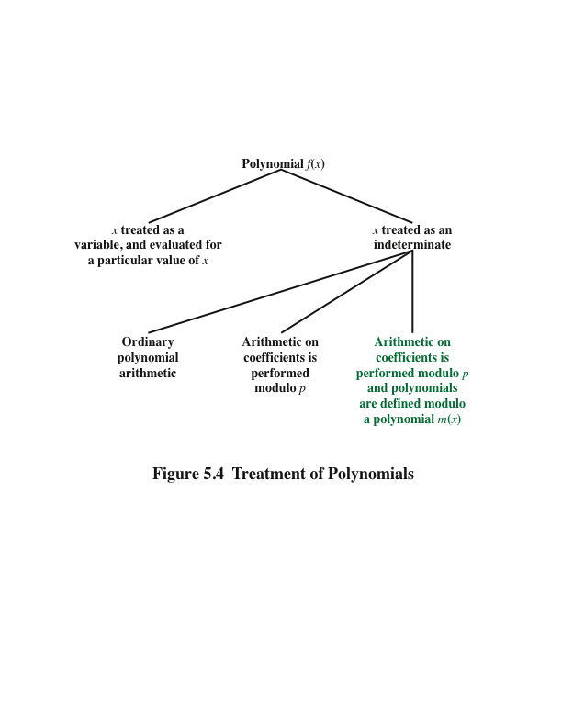
Notes:
Before continuing our discussion of finite fields, we need to introduce the interesting
subject of polynomial arithmetic. We are concerned with polynomials in a single
variable x , and we can distinguish three classes of polynomial arithmetic. (Figure 5.4)
• Ordinary polynomial arithmetic, using the basic rules of algebra.
• Polynomial arithmetic in which the arithmetic on the coefficients is performed
modulo p ; that is, the coefficients are in GF(p ).
• Polynomial arithmetic in which the coefficients are in GF(p ), and the polynomials
are defined modulo a polynomial m (x ) whose highest power is some integer n .

Slide 20
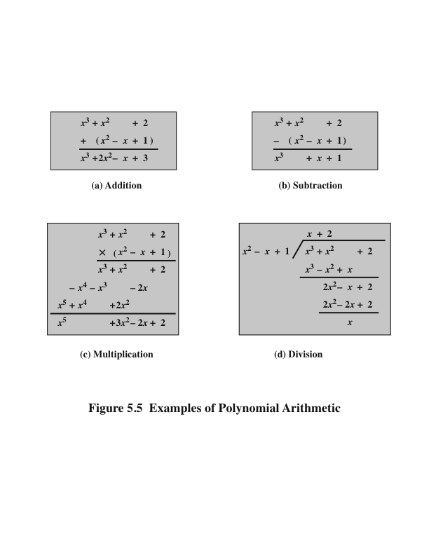
Notes:
Examples of Polynomial Arithmetic

Slide 21
Polynomial Arithmetic With Coefficients in Z_{p}
If each distinct polynomial is considered to be an element of the set, then that set is a ring
When polynomial arithmetic is performed on polynomials over a field, then division is possible
    Note: this does not mean that exact division is possible
    If we attempt to perform polynomial division over a coefficient set that is not a field, we find that division is not always defined
    Even if the coefficient set is a field, polynomial division is not necessarily exact
    With the understanding that remainders are allowed, we can say that polynomial division is possible if the coefficient set is a field
Notes:
Let us now consider polynomials in which the coefficients are elements of some
field F; we refer to this as a polynomial over the field F. In that case, it is easy to
show that the set of such polynomials is a ring, referred to as a polynomial ring .
That is, if we consider each distinct polynomial to be an element of the set, then
that set is a ring.
When polynomial arithmetic is performed on polynomials over a field, then
division is possible. Note that this does not mean that exact division is possible.
Let us clarify this distinction. Within a field, given two elements a and b , the
quotient a /b is also an element of the field. However, given a ring R that is not a
field, in general, division will result in both a quotient and a remainder; this is not
exact division.
Now, if we attempt to perform polynomial division over a coefficient set that
is not a field, we find that division is not always defined.
However, as we demonstrate presently, even if the coefficient set is a field,
polynomial division is not necessarily exact. In general, division will produce a quotient
and a remainder.
With the understanding that remainders are allowed, we can say that polynomial
division is possible if the coefficient set is a field.

Slide 22
Polynomial Division
We can write any polynomial in the form:
  f(x) = q(x) g(x) + r(x)
  r(x) can be interpreted as being a remainder
  So r(x) = f(x) mod g(x)
If there is no remainder we can say g(x) divides f(x)
  Written as g(x) | f(x)
  We can say that g(x) is a factor of f(x)
  Or g(x) is a divisor of f(x)
A polynomial f(x) over a field F is called irreducible if and only if f(x) cannot be expressed as a product of two polynomials, both over F, and both of degree lower than that of f(x)
  An irreducible polynomial is also called a prime polynomial
Notes:
Note that we can write any polynomial in the form of f(x) = q(x) g(x) + r(x), where division of f(x) by g(x) results in a quotient q(x) and remainder r(x). Can then extend the concept of divisors from the integer case, and show that the Euclidean algorithm can be extended to find the greatest common divisor of two polynomials whose coefficients are elements of a field.
Define an irreducible (or prime) polynomial as one with no divisors other than itself & 1. If compute polynomial arithmetic modulo an irreducible polynomial, this forms a finite field, and the GCD & Inverse algorithms can be adapted for it.

Slide 23
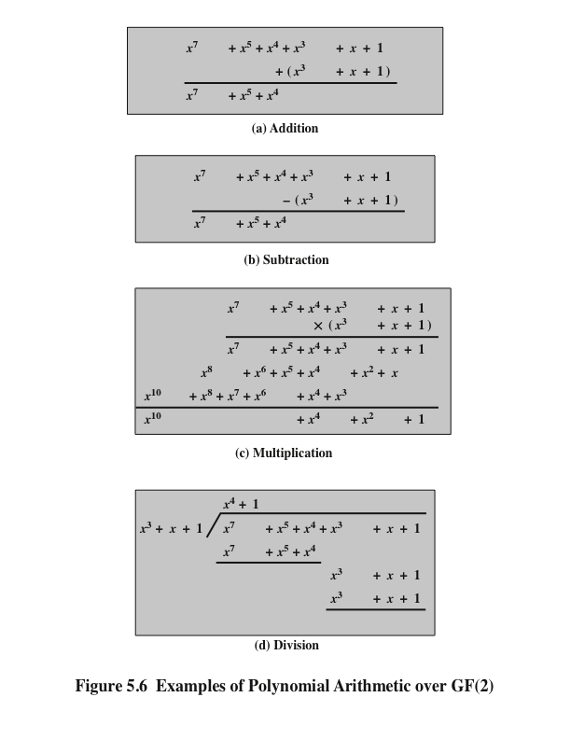
Example of Polynomial Arithmetic
Over GF(2)
(Figure 5.6 can be found on page 137 in the textbook)
Notes:
Figure 5.6 shows an example of polynomial arithmetic over GF(2).

Slide 24
Polynomial GCD
The polynomial c(x) is said to be the greatest common divisor of a(x) and b(x) if the following are true:
  c(x) divides both a(x) and b(x)
  Any divisor of a(x) and b(x) is a divisor of c(x)
An equivalent definition is:
  gcd[a(x), b(x)] is the polynomial of maximum degree that divides both a(x) and b(x)
The Euclidean algorithm can be extended to find the greatest common divisor of two polynomials whose coefficients are elements of a field
Notes:
We can extend the analogy between polynomial arithmetic over a field and integer
arithmetic by defining the greatest common divisor as follows. The polynomial c(x)
is said to be the greatest common divisor of a(x) and b(x) if the following are true.
1. c(x) divides both a(x) and b(x).
2. Any divisor of a(x) and b(x) is a divisor of c(x).
An equivalent definition is the following: gcd[a (x ), b (x )] is the polynomial of
maximum degree that divides both a (x ) and b (x ).
We can adapt the Euclidean algorithm to compute the greatest common
Divisor of two polynomials.

Slide 25
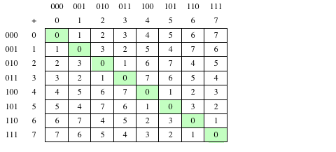
Table 5.2(a)
Arithmetic in GF(2³)
(a) Addition
Notes:
Table 5.2 Arithmetic in GF(23)

Slide 26
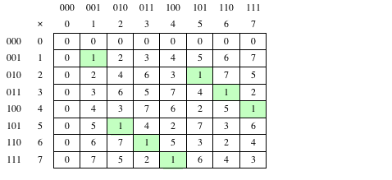
Table 5.2(b)
Arithmetic in GF(2³)
(b) Multiplication
Notes:
Table 5.2 Arithmetic in GF(23)

Slide 27
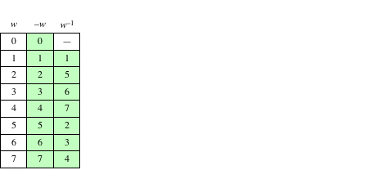
Table 5.2(c)
Arithmetic in GF(2³)
(c) Additive and multiplicative inverses
Notes:
Table 5.2 Arithmetic in GF(23)

Slide 28
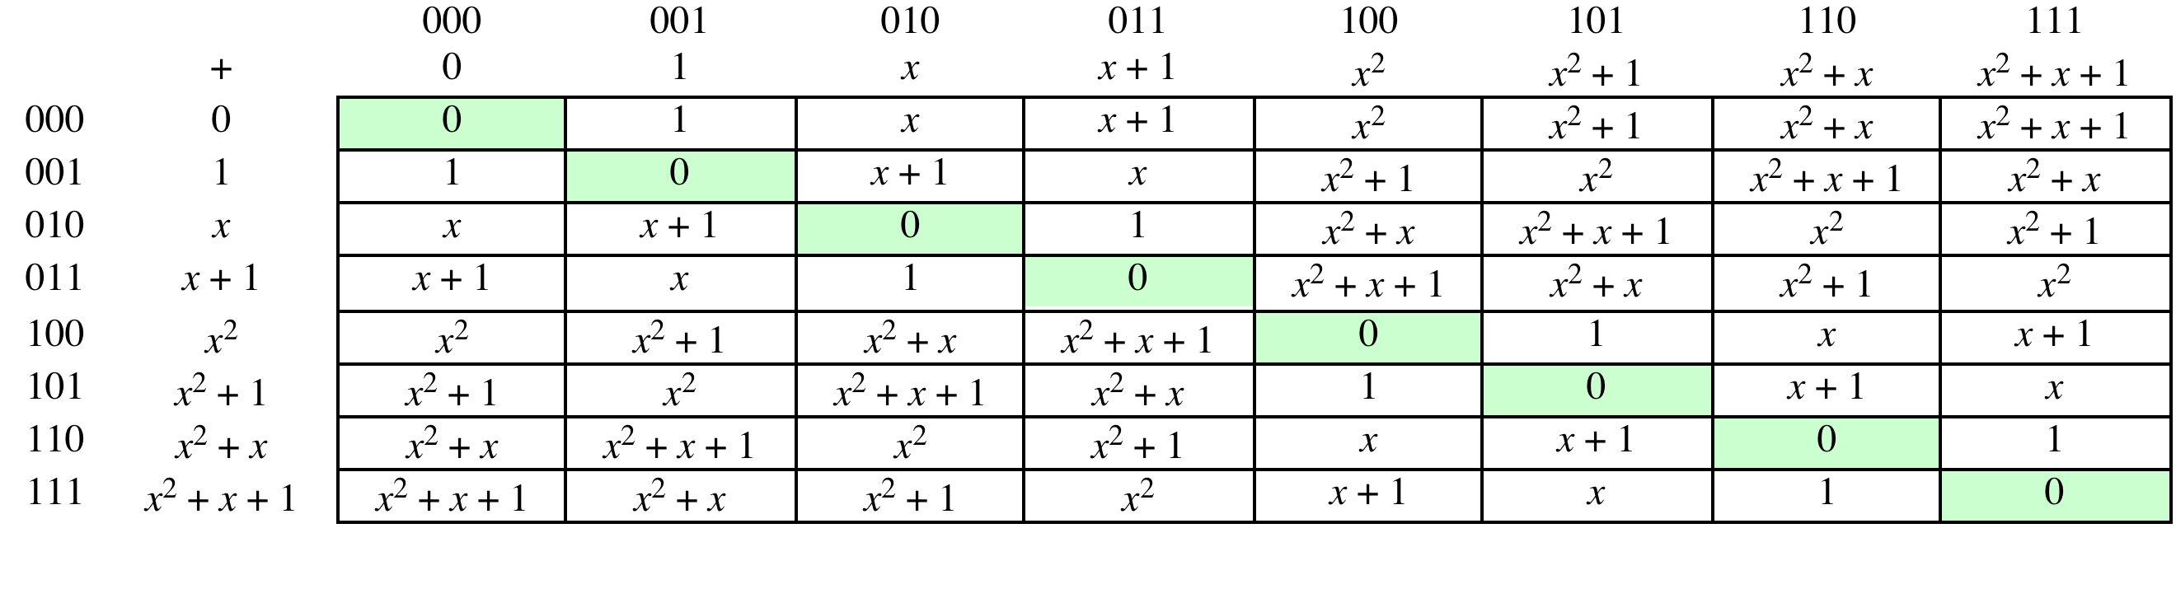
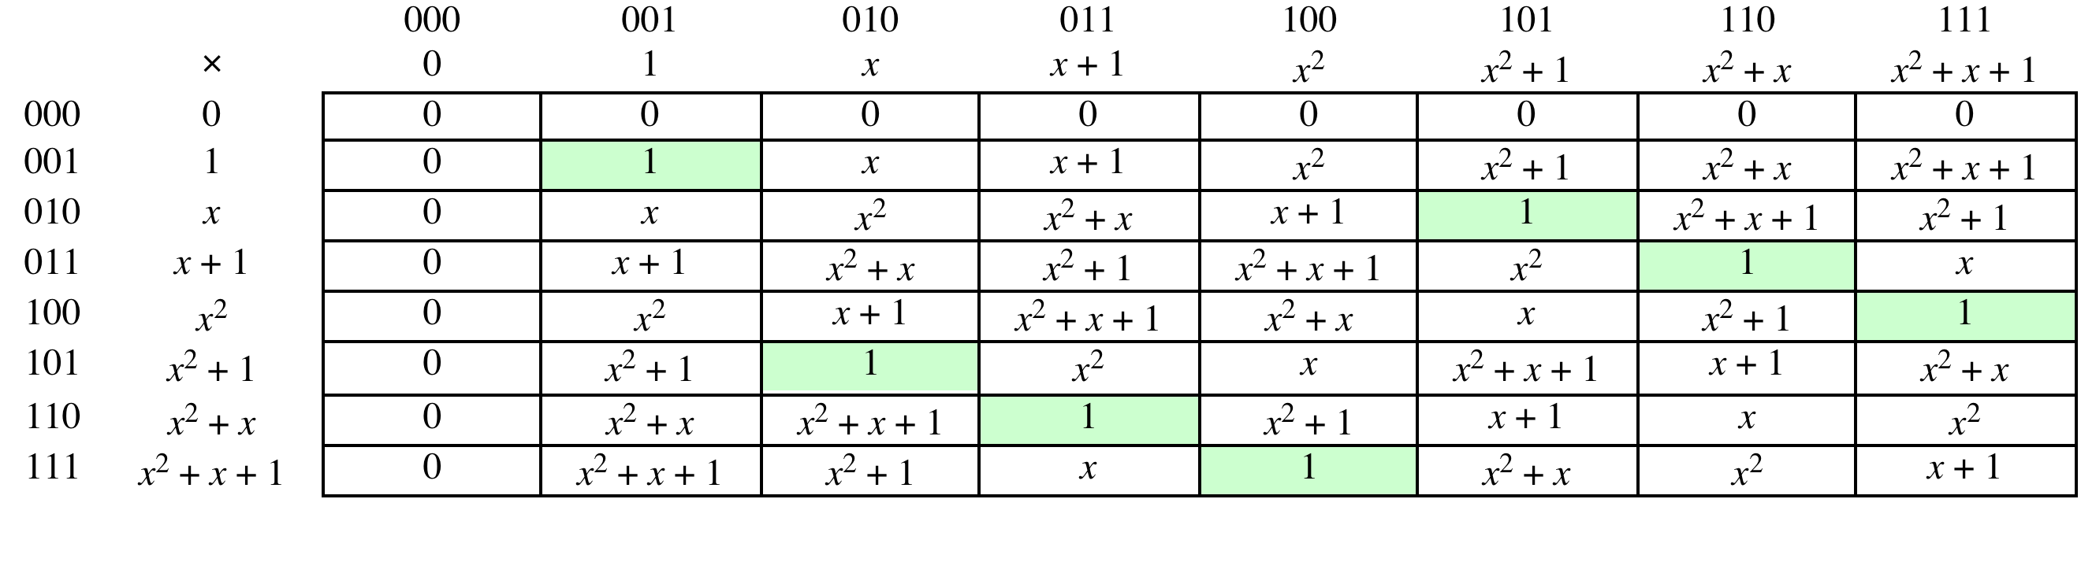
Table 5.3 (page 144 in textbook)
Polynomial Arithmetic Modulo (x³ + x + 1)
(a) Addition
(b) Multiplication
Notes:
Example shows addition & multiplication in GF(2³)

Slide 29
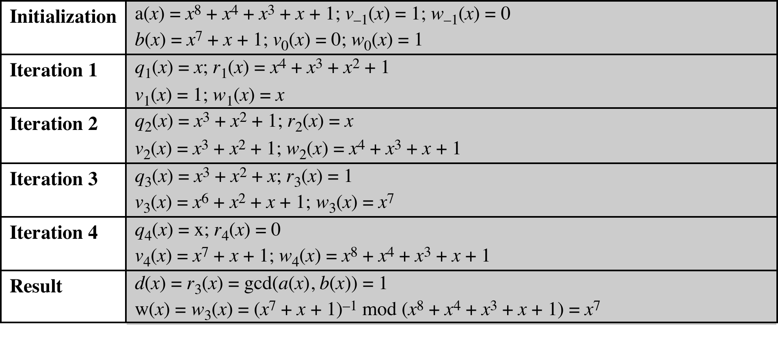
Table 5.4
Extended Euclid [(x⁸ + x⁴ + x³ + x + 1), (x⁷ + x + 1)]
(Table 5.4 can be found on page 146 in textbook)
Notes:
Table 5.4 Extended Euclid [(x⁸ + x⁴ + x³ + x + 1), (x⁷ + x + 1)]

Slide 30
Computational Considerations
Since coefficients are 0 or 1, they can represent any such polynomial as a bit string
Addition becomes XOR of these bit strings
Multiplication is shift and XOR
  cf long-hand multiplication
Modulo reduction is done by repeatedly substituting highest power with remainder of irreducible polynomial (also shift and XOR)
Notes:
A key motivation for using polynomial arithmetic in GF(2^{n}) is that the polynomials can be represented as a bit string, using all possible bit values, and the calculations only use simple common machine instructions - addition is just XOR, and multiplication is shifts & XOR’s. See text for additional discussion. The shortcut for polynomial reduction comes from the observation that if in GF(2^{n}) then irreducible poly g(x) has highest term x^{n} , and if compute x^{n} mod g(x) answer is g(x)- x^{n}

Slide 31
Using a Generator
A generator g of a finite field F of order q (contains q elements) is an element whose first q-1 powers generate all the nonzero elements of F
  The elements of F consist of 0, g⁰, g¹, . . . ., g^{q-2}
  Consider a field F defined by a polynomial fx
  An element b contained in F is called a root of the polynomial if f(b) = 0
  Finally, it can be shown that a root g of an irreducible polynomial is a generator of the finite field defined on that polynomial
Notes:
An equivalent technique for defining a finite field of the form GF(2^{n} ), using the
same irreducible polynomial, is sometimes more convenient. To begin, we need two
definitions: A generator g of a finite field F of order q (contains q elements) is an
element whose first q - 1 powers generate all the nonzero elements of F. That is, the
elements of F consist of 0, g⁰ , g¹ , c , g^{q-2} . Consider a field F defined by a polynomial
f (x ). An element b contained in F is called a root of the polynomial if f (b ) = 0.
Finally, it can be shown that a root g of an irreducible polynomial is a generator of the
finite field defined on that polynomial.

Slide 32
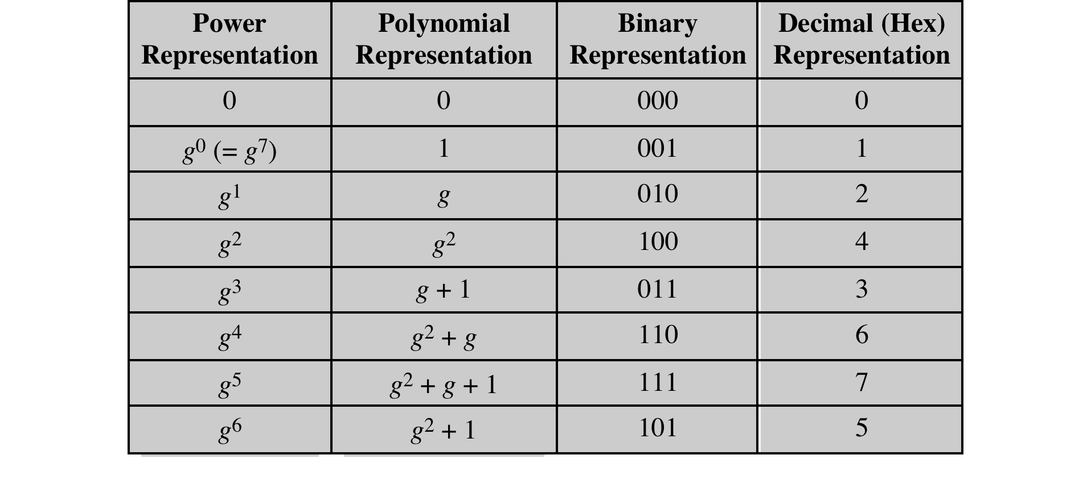
Table 5.5
Generator for GF(2³) using x³ + x + 1
Notes:
Table 5.5 Generator for GF(2³) using x³ + x + 1

Slide 33
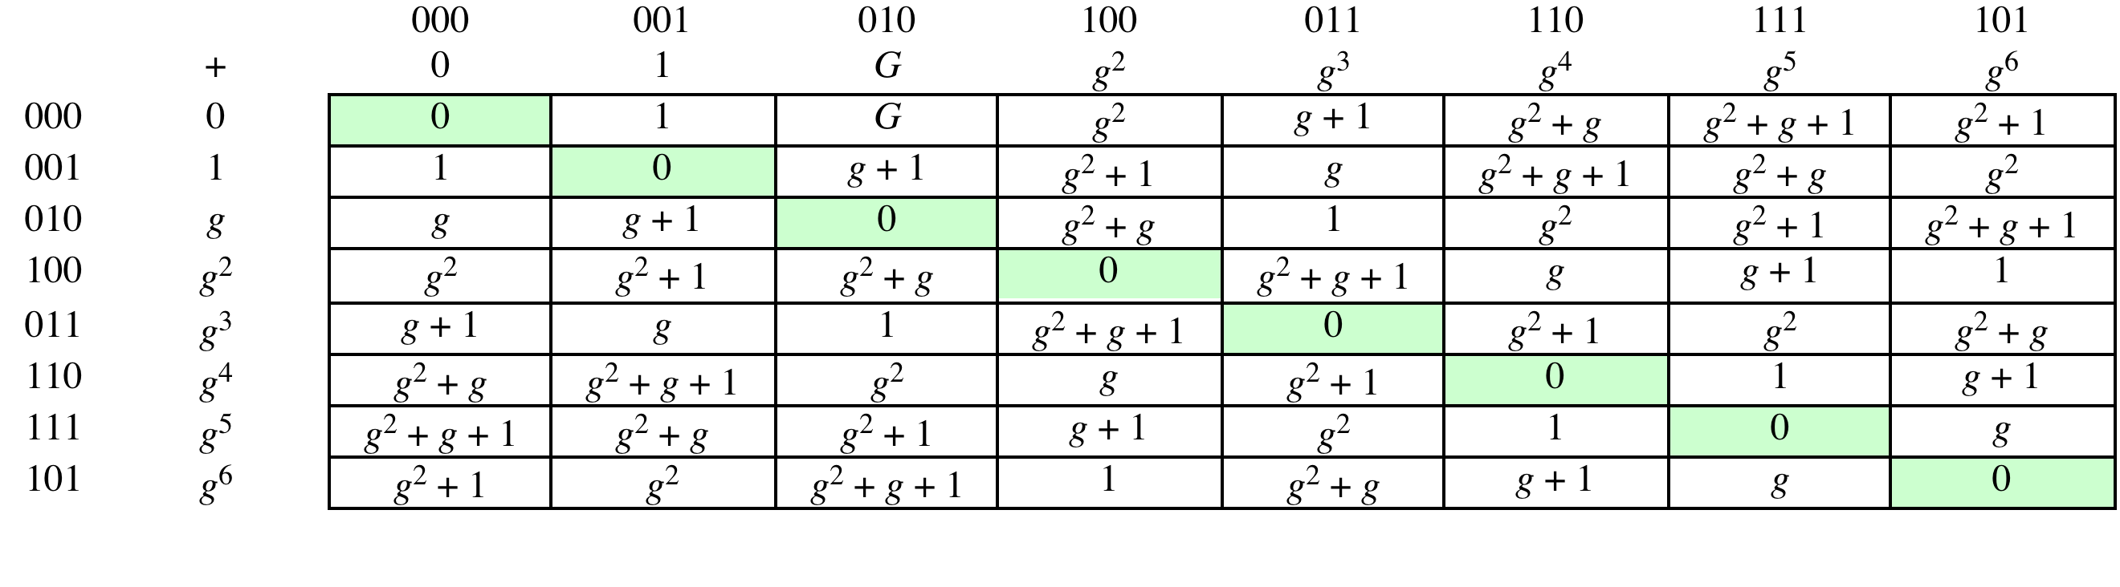
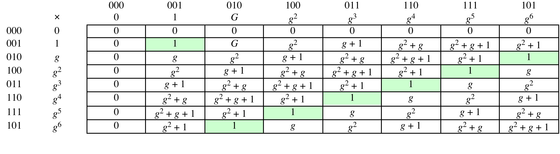
Table 5.6 (page 150 in textbook)
GF(2³) Arithmetic Using Generator for the Polynomial (x³ + x + 1)
(a) Addition
(b) Multiplication
Notes:
Table 5.6 GF(2³) Arithmetic Using Generator for the Polynomial (x³ + x + 1)

Slide 34
Summary
Groups
  Abelian group
  Cyclic group
Finite fields of the form GF(p)
  Finite fields of Order p
  Finding the multiplicative inverse in GF(p)
Polynomial arithmetic
  Ordinary polynomial arithmetic
  Polynomial arithmetic with coefficients in Z_{p}
  Finding the greatest common divisor
  Rings
  fields
Finite fields of the form GF(2^{n})
  Motivation
  Modular polynomial arithmetic
  Finding the multiplicative inverse
  Computational considerations
  Using a generator
Notes:
Chapter 5 summary.

